Slide 1
DISCRIMINATION a social issue.
Student sample
396-07
IB

Slide 2
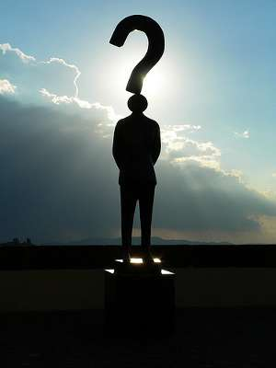
Why do people discriminate against others?
(Tyrrel, M 2010)

Slide 3
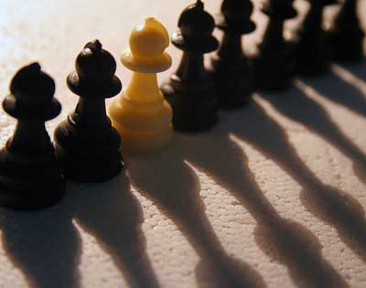
Because they are different from the rest. Or maybe one group thinks they are superior to another.
(Ballandyorke)

Slide 4

Discrimination comes in many different forms.
( loudonwebdesign )

Slide 5
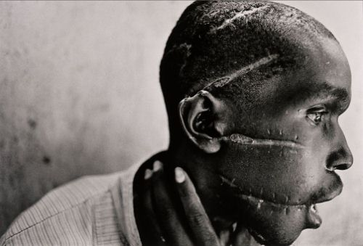
Whether it’s the hatred and violence of racism…
(Grant, 2009)

Slide 6
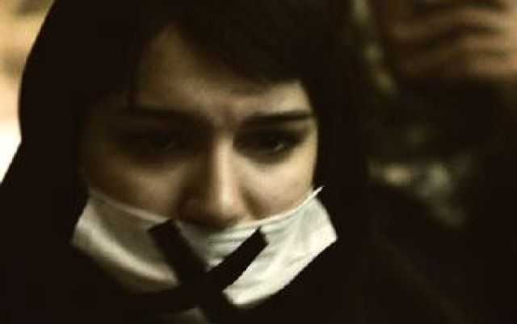
or the oppression of sexism.
(Daniela 2005)

Slide 7
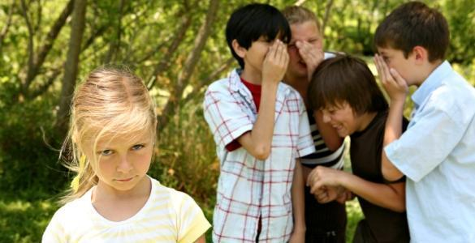
The bottom line is that discrimination brings hurt, pain, hatred and loss to all it touches.
(Yang, 2011)

Slide 8

We give more rights and respect to certain people and give less or none to others who are different because of stereotypes, racism and ignorance.
(Kokhanchikov 2007)

Slide 9
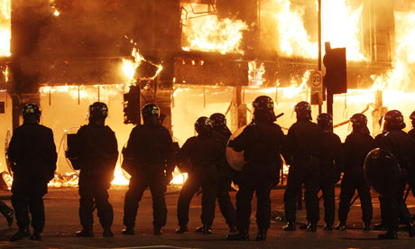
This causes anything from riots and rebellions, to hate crimes and genocide.
(Green 2011)

Slide 10

Discrimination is a difficult problem to solve, but we must work hard and struggle to end it, so we can all live in…
(Lady 2012)

Slide 11

PEACE!
(HoNey 2010)

